Slide 1

Obesity Prediction project.
AI model.

Slide 2
Libraries
1) numpy :
a library for handling numbers, matrices and mathematical operations.
2) pandas :
Pandas is one of the most important libraries for data analysis and data manipulation. Allow Reading, Cleaning, Exploring and Processing datasets.
3) matplotlib.pyplot :
Matplotlib is a library used for visualizing data. The pyplot allows to make basic plots
4) Seaborn :
more advanced visualization library built on top of Matplotlib. Used for statistical plots like heatmaps, makes your charts look better by default.
5) plotly.express :
library for creating interactive plots its charts allow users to zoom, hover, and explore the data.

Slide 3
READING AND COMBINING THE TRAIN AND TEST DATASETS.
1) pd.read_csv:
Is a function in Pandas that read datasets from CVS files and
convert into DataFrame once for training dataset and once for
testing dataset.
2) combined_df = pd.concat([train_df, test_df], ignore_index=True):
Combines the training and testing datasets into one dataframe.
pd.concat([...]) stacks the two datasets on top of each other.
ignore_index=True resets the row numbering (index) so it runs from 0 to N without repeating.

Slide 4
Display and Rename
1) combined_df.tail():
Display the last 5 rows of the DataFrame,(tail is a Panads function).
2) combined_df.rename:
Renames a column in the DataFrame (inplace=True: apply the change directly to combined_df )

Slide 5
CHECKING NULLS AND DUPLICATED VALUES AND HANDING IT
1) combined_df.drop_duplicates(inplace=True):
Removes duplicate rows from the DataFrame.
  Inplace=True means the changes are made directly to combined_df.
2) combined_df.isna().sum():
Checks for missing values (NaNs) in the DataFrame and gives you a count of missing values in each column.
3) combined_df.dropna(inplace=True):
Removes all rows that contain any missing (NaN) values from the
DataFrame.
4) print(combined_df.duplicated().sum()):
Counts and prints how many duplicate rows still exist in the DataFrame.

Slide 6
FEATURE SELECTION
1) SelectKBest:
Allows pick the top K best features based on a scoring method.
2) chi2:
Is the Chi-squared test, a statistical test that works with categorical target variables.
3) Xtest = combined_df.drop('ObesityLevel', axis=1):
You’re removing the target columnto create the feature set xtest.
4) y = combined_df['ObesityLevel’]:
This is your target variable (what you want to predict).

Slide 7
5) X_kbest = chiSelector.fit(xtest, y):
Fits the selector to your data (features and target).
It calculates the Chi-squared scores for each feature based on how strongly it is associated with the target.

Slide 8
Encoding
ML models can’t read text, so we convert strings to numbers.
It makes the dataset fully numerical, which is required for training.
Some mappings (like CAEC or CALC) reflect order, which helps some models understand intensity.

Slide 9
MODELS APPLIANCE.

Slide 10
Logistic Regression Model Performance
We implemented a Logistic Regression model as our baseline approach. This model is simple, fast, and works well
for linearly separable data. However, it struggled with the complexity of obesity prediction, suggesting that the
relationships between our features and obesity levels are non-linear.
The model's performance metrics revealed significant limitations in capturing the nuanced patterns in health
indicators. The classification report showed varying performance across different obesity categories, with some
classes being predicted more accurately than others.
After using grid search the accuracy increased by 10%

Slide 11
Low
Accuracy (62%)
Poor overall prediction performance
Varied
Precision
Inconsistent across obesity classes
Limited
Recall
Failed to identify many true positives
Weak
F1 Score
Poor balance of precision and recall

Slide 12
Random Forest Model Performance
The Random Forest Classifier significantly outperformed the Logistic Regression model, achieving 91% accuracy. This ensemble method excels at capturing
complex, non-linear relationships in the data by combining multiple decision trees, making it well-suited for obesity prediction.
The model demonstrated strong performance across all metrics, with high precision, recall, and F1-scores. The classification report revealed consistent
performance across different obesity categories, indicating the model's ability to distinguish between various levels of obesity

Slide 13
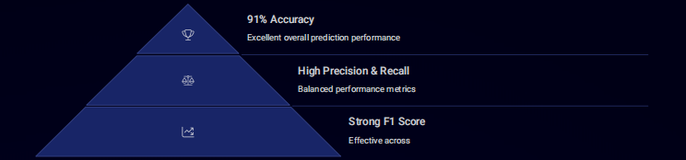

Slide 14
SUPPORT VECTOR MACHINES (SVM)
SVM, is a powerful supervised machine learning algorithm used primarily for classification and regression tasks. In classification, SVM tries to maximize the margin between the closest data points of different classes (these are called support vectors). SVM will try to draw a line (or a plane in higher dimensions) that best separates the two classes with the widest possible gap between the classes.
The data points that are closest to the boundary are the support vectors, which "support" the boundary.
A LinearSVC model was used for classification.
The model was trained using x_train and y_train.
After training, predictions were made on x_test.

Slide 15
Additionally, the following were printed:
  Classification Report: Detailed performance for each class.
  Confusion Matrix: Shows correct vs. incorrect predictions per class.
  And if we changed the number of iteration to ‘1’ the accuracy decreases by 11%.
The model performance was evaluated using the following metrics:
  Accuracy: Moderate model performance(64.9%).
  Precision (macro): Average precision across all classes.
  Recall (macro): Average recall across all classes.
  F1 Score (macro): Harmonic mean of precision and recall

Slide 16
K-NEAREST NEIGHBORS (KNN)
A KNeighborsClassifier was used with k = 5 (i the 5 nearest neighbors).
The model was trained using x_train and y_train and the predictions were made on x-set( like SVM ).
The model performance was evaluated using the following metrics:
  Accuracy: Overall proportion of correct predictions(82.7%).
  Precision (macro): Average precision across all classes.
  Recall (macro): Average recall across all classes.
  F1 Score (macro): Balanced metric combining precision and recall

Slide 17
Additionally, the following were printed:
  Classification Report: Detailed performance per class.
  Confusion Matrix: Summarizes prediction errors and correct classifications.
  And if we changed the N neighbors to 8 the accuracy decreases by 5%

Slide 18
Light Gradient Boosting Classifier (LGBM):
Powerful machine learning algorithm used for classification and regression tasks. It builds an ensemble of decision trees sequentially to improve model accuracy. GBM builds a series of trees where each tree fixes the
errors of the previous one. It uses gradient descent to minimize prediction errors.
It’s great for improving predictive performance on structured/tabular data.
Accuracy achieved by this model is 92% which is perfectly satisfiable.

Slide 19
Gradient Boosting Classifier (cont) :
The model is trained using x_train and y_train.
Predictions are made on x_test.
Evaluation metrics include:
  Precision (macro): Correctness of positive predictions (averaged per class).
  Recall (macro): Ability to find all positive cases (averaged).
  F1 Score (macro): Balance between precision and recall.
Outputs:
  Classification report: Detailed metrics per class.
  Confusion matrix: Shows correct vs incorrect predictions.

Slide 20
Extreme Gradient Boosting (XGBOOST)
Powerful machine learning algorithm based on gradient boosting. It's known for being fast, accurate, and efficient, and is widely used in real-world applications and data science competitions (like Kaggle).
Builds an ensemble (collection) of decision trees, where each new tree tries to correct the errors made by the previous ones.
Used XGBoostClassifier for multi-class classification.
Evaluation metrics were calculated:
  Accuracy: Strong predictive performance(87.4%).
  Precision / Recall / F1 Score (macro): Averaged across all classes equally.

Slide 21
Extreme Gradient Boosting (XGBOOST) (cont):
Outputs included:
  Classification Report: Detailed performance per class.
  Confusion Matrix: Visualizes true vs. predicted labels.
Key parameters:
  n_estimators=100: Number of trees.
  max_depth=6: Maximum tree depth.
  learning_rate=0.1: Step size for updates.
  objective='multi:softmax': Multi-class classification.
  num_class: Number of unique target classes.
  If we tried to make the n_estimators=10 and max_depth=2 we will get 60.9% accuracy.

Slide 22
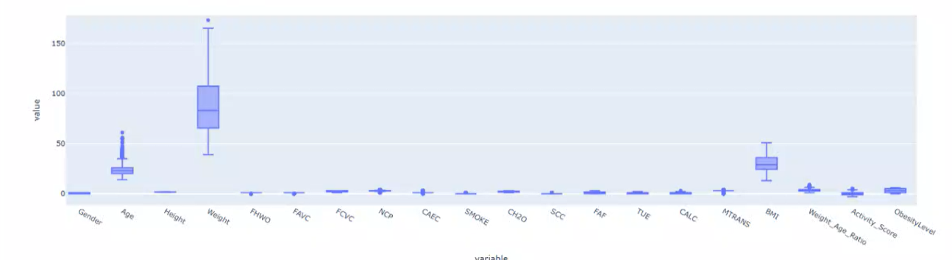
VISUALIZATIONS
Before handling outliers :

Slide 23
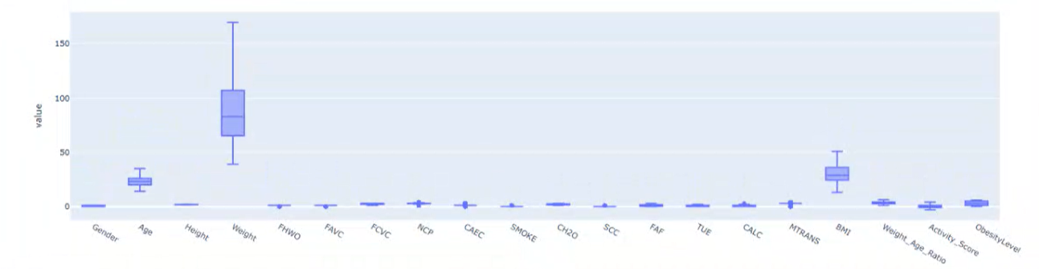
VISUALIZATIONS (cont)
After handling outliers :
  Compute Q1 (25th percentile) and Q3 (75th percentile).
  Calculate the IQR = Q3 - Q1.
  Define lower and upper bounds:
    lower_bound = Q1 - 1.5 * IQR
    upper_bound = Q3 + 1.5 * IQR
    Replace any values below the lower bound with the lower bound and above the upper bound with the upper bound.

Slide 24
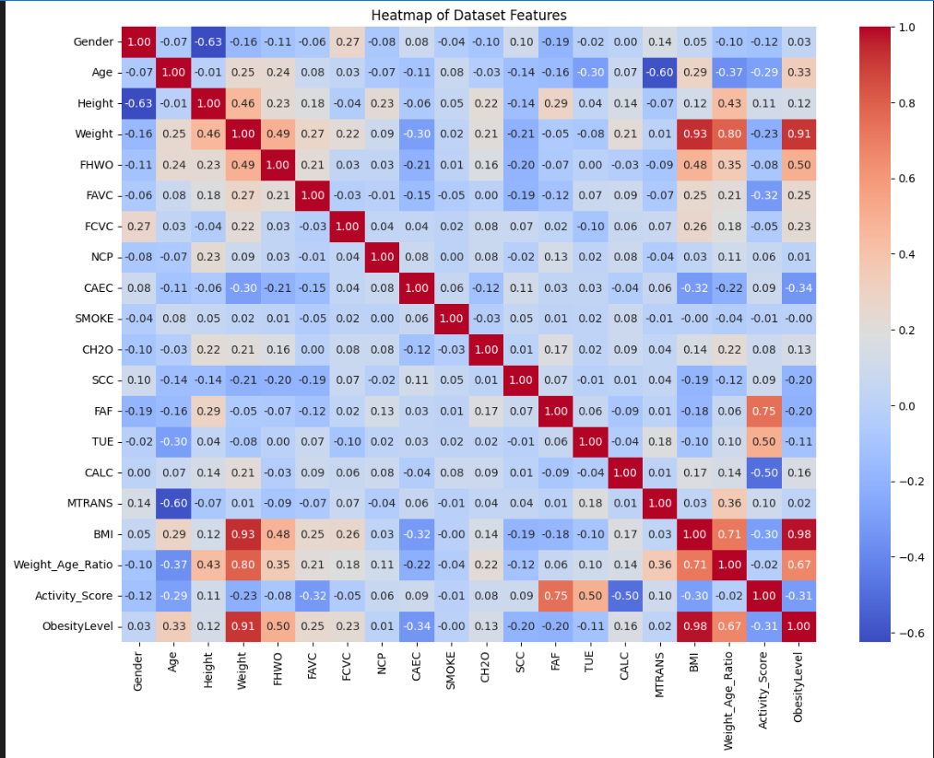
Calculate the correlation matrix.

Slide 25

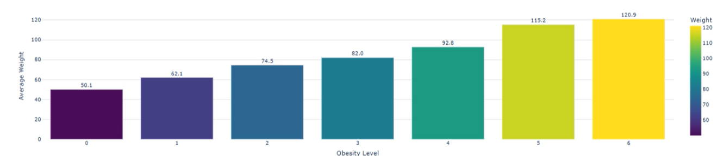

Average Weight by obesity Level
Distribution of CAEC (Frequency of consuming food between meals)

Slide 26
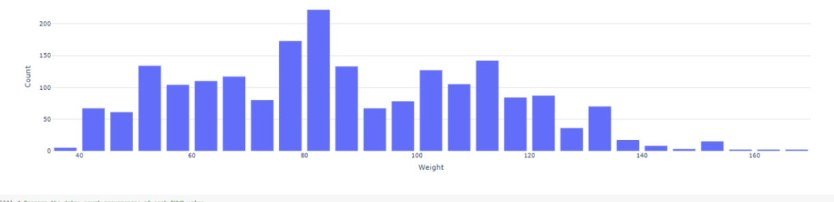
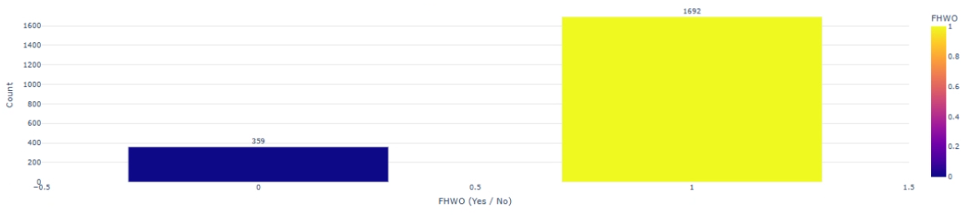
Distribution of weights
Family history with overweight Distribution

Slide 27
Lifestyle Factor And Obesity
1) Highly Related Factors:
Weight, BMI, and Weight_Age_Ratio are most strongly associated with obesity levels, both statistically and intuitively.
2) Lifestyle Behaviors Influencing Obesity:
  High-calorie food consumption (FAVC) and eating between meals (CAEC) show a positive relationship with obesity.
  Vegetable consumption (FCVC) and physical activity (FAF) show a negative relationship, indicating healthier habits correlate with lower obesity
  Alcohol consumption (CALC) and number of meals (NCP) also show some positive relationship.

Slide 28
Lifestyle Factor And Obesity (cont):
3) Weaker or Non-significant Factors:
  Smoking, screen time (TUE), and transportation (MTRANS) seem less correlated.

Slide 29
Conclusion
In this project, we developed and evaluated machine learning models to predict obesity levels based on various personal and lifestyle features. After preprocessing the dataset, we applied multiple classification algorithms, including [mention the models used, e.g., Logistic Regression, Decision Tree, Random Forest], and assessed their performance using metrics such as accuracy, precision, recall, and F1-score.
The results showed that [mention the best-performing model] achieved the highest accuracy of [insert accuracy, e.g., 92%], indicating its effectiveness in identifying individuals at risk of obesity. These findings highlight the potential of machine learning in supporting early intervention strategies and personalized health recommendations.

Slide 30
Future work may involve testing the models on more diverse datasets, incorporating additional features such as genetic or psychological factors, and deploying the model in real-world health monitoring applications.

Slide 31
Thank You

